Slide 1
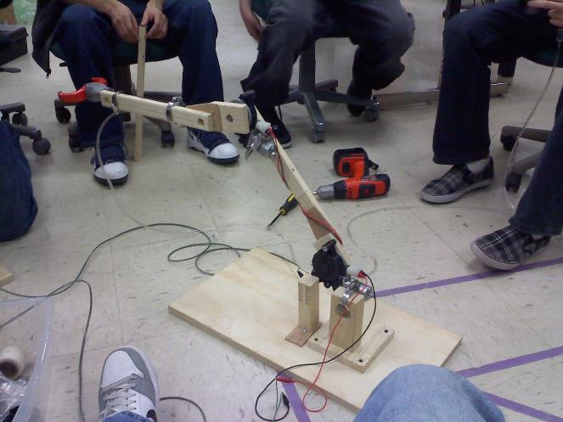
Robotics Converting Ideas into Real Hardware - QUICKLY
LabRat Scientific
© 2018

Slide 2
The purpose of this lesson is to outline a process (not necessarily the only process) that can be used to move a raw idea to real hardware in the shortest possible time period.
Design competitions must be completed within a finite amount of time. It is common for teams to spend too much time thinking of ideas… It is also common for teams to waste time pursuing ideas that have little chance of working out. Ideas need to be tested QUICKLY, and discarded early on in the development process if they don’t appear to be feasible.
KEY POINT: When testing an idea, don’t waste time building fancy, complex, metallic parts unless absolutely necessary – this will waste too much time. Use materials that are easy to work with…

Slide 3
Moving an IDEA to REALITY - Swiftly
1. Develop a list of possible ideas by conducting BRAIN STORMING sessions. There will likely be several possible solutions to any given problem. The trick is to find the most feasible idea in the shortest amount of time…
2. Spend a few design sessions trying to develop “Mock-ups” to get a better understanding of how complex that particular solution might be.
3. Drop any ideas that could not be demonstrated by a Mock-up. This is an indication that the idea may not be feasible or may be too complex.
4. Spend a few design sessions trying to advance the ideas by building “Prototypes” (working models) of the idea. Use real motors and components to wring out some details.
5. Examine the prototypes and select the ones that best solve the problems.

Slide 4
Brainstorming Sessions
The entire team works together to develop a list of possible ideas to solve all the technical problems.
The device (i.e. robot) will have multiple individual systems (drive system, ball collector, frisbee shooter, manipulator arm, etc.)
There will likely be several possible solutions for each of the systems
No ideas are thrown out during the initial list-building process. It is important to get a lot of ideas to consider…
The list is then assessed and debated to eliminate grossly unreasonable ideas (the team isn’t going to be able to work on every idea).
End the Brainstorming Process by assigning team members to Mock-up development tasks. Target two team members per task (two heads are better than one) and you may not have a big enough team to have three or more members on each task.

Slide 5
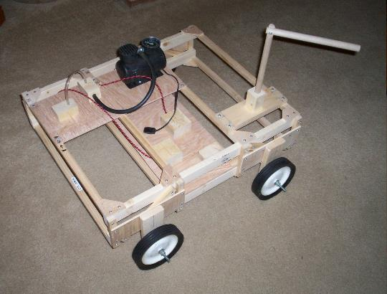
Mock-ups
Semi-functioning devices
Could be devices that are manually manipulated
Used to see how things might fit together
Built out of simple materials (e.g. wood) so they can be built quickly
Could use SolidWorks during this phase of the design process if the team has the capability
Programmer needs to be very skilled so an accurate model can be “built” quickly
Difficult for designer to efficiently dictate design to a programmer (kinda has to be a one-on-one activity)
Real hardware is usually better – you don’t get as much out of building a “virtual” device…
Wooden Mock-up of robot chassis used to investigate modular design concept

Slide 6
Prototypes
Functioning devices that use actual motors and maybe even sensors.
Controlled using manual switches instead of the computer and software (software development would take too long during this phase).
Used to verify ideas will actually be functional.
Once again, assembled using simple materials to they can be built quickly.
Plastic
Wood
Consider building high fidelity prototypes so they can be used in the production unit if schedule becomes an issue.
Functioning prototype of a robotic arm using actual drive motors

Slide 7
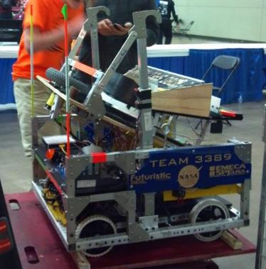
Production Unit
The “final” product to be used in the competition
Components are based on prototype hardware
Final materials are used (e.g. metal)
Prototype parts can be used in the production unit temporarily so testing can get underway as early as possible
Final components and parts can be added as they become available
In a pinch, well built prototype devices could be used if schedule is exhausted

Slide 8
Example of the Development Process (6-week Project)
Week 1
Week 1
Week 1
Problem/Task Identified
Problem/Task Studied
Ideas Brainstormed
Week 1
Week 2
Week 2
Ideas with best potential identified
Mock-ups Developed
Works
Prototypes Developed
Works
Doesn’t Work
Week 3 & 4
Week 5
Week 6
Production Unit
Test
Practice
Ready to Ship
Tweak
Note: Weeks 3 & 4 will likely extend into week 5, but don’t put that in the initial plan because doing so will ensure happens…

Slide 9
Key Points to Remember
Assess and Design as QUICKLY as possible
Use the internet to research ideas
Mock-ups and prototypes can take a little time, but the can be very helpful in identifying feasible solutions
Trying “something” can help get your creative juices flowing
Mock-ups and prototypes must be built quickly using easy to use materials
Don’t waste time building “high quality” parts for mock-ups or prototypes
A had cut wooden disk can be made quicker than one that is machined out of aluminum. The wooden disk is probably enough to prove the idea will work
Wood beams screwed together with wood screws can be modified quicker than aluminum beams that have drilled and tapped holes

Slide 10
Key Points to Remember
Prototype parts don’t have to look good, they just need to prove the idea is functional
Mock-up and Prototype parts only need to last long enough to test the idea – they don’t need to survive the rigors of competition
Keep in mind that some prototype parts may need to be machined, but do this as little as possible to save time…
If you are made responsible for a task, you need to complete the task – ON TIME!
No walking away if you get stumped…
Your failure will end up being the team’s failure!

Slide 11
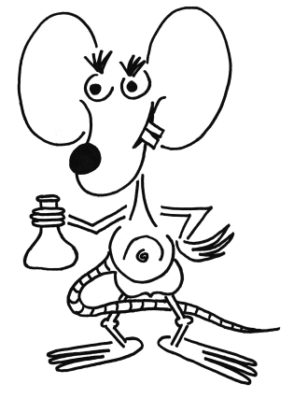
QUESTIONS?

